Slide 1
Flight Price Prediction
Submitted By:
Milind B. Kuwar

Slide 2
Problem Statement
Flight ticket prices can be something hard to guess, today we might see a price, check out the price of the same flight tomorrow, it will be a different story. We might have often heard travellers saying that flight ticket prices are so unpredictable. Optimal timing for airline ticket purchasing from the consumer’s perspective is challenging principally because buyers have insufficient information for reasoning about future price movements. In this project we simulate various models for computing expected future prices and classifying whether this is the best time to buy the ticket.

Slide 3
Business Goal
Main objective is to analyse and build a dynamic machine learning model that can predict the flight prices on the basis of information of the flight provided by the airlines

Slide 4
Dataset Exploration
· The dataset contains 1559 rows and 9 columns
· Price is our dependent variable.
· We created new features from old ones.
· All columns were object data types we converted in numeric.
· There were no empty cells in the dataset
· Trimmed few columns

Slide 5
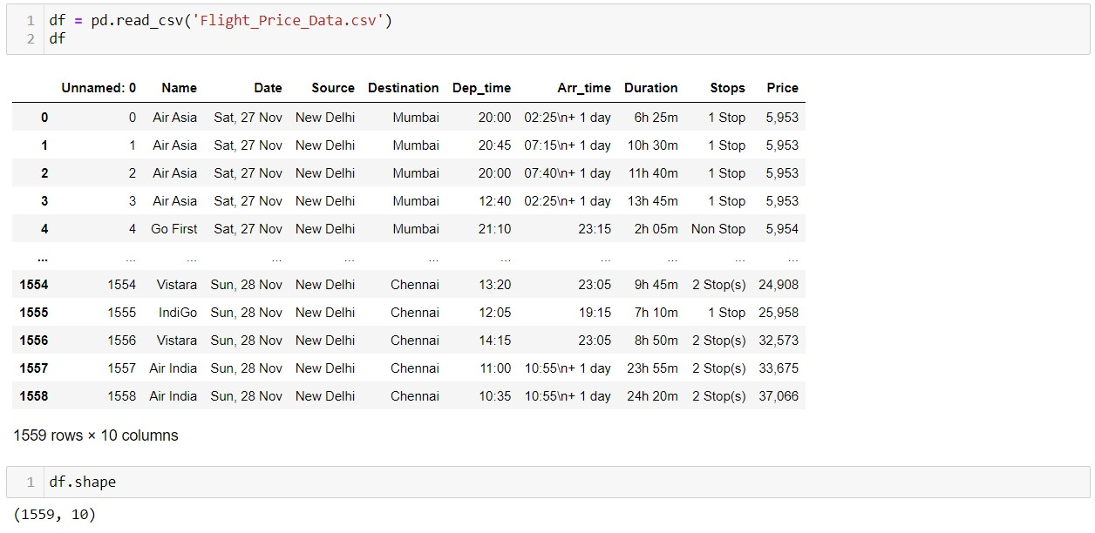
Exploratory Data Analysis

Slide 6
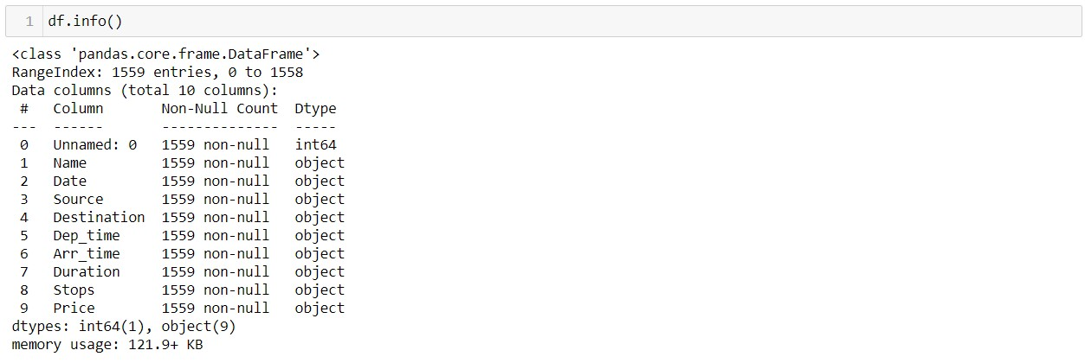
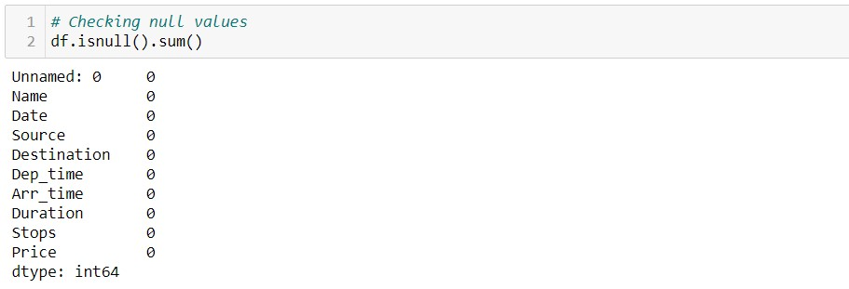
Then we further checked more about data using info, checked datatypes using dtypes, shapes using .shape, columns using .columns, null values using .isnull.sum and further visualize it through heatmap as follows:

Slide 7
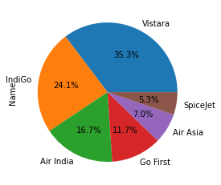
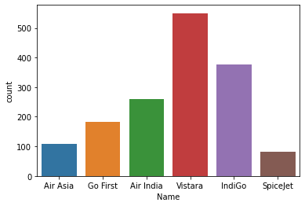
Data Visualization
Vistara is higher and lowest is Spicejet.
AirIndia and Indigo has comparable, followed by GoFirst.

Slide 8
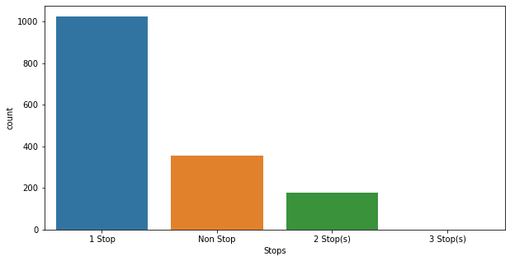
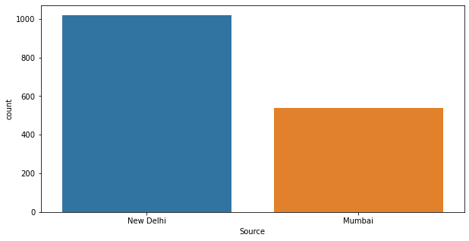
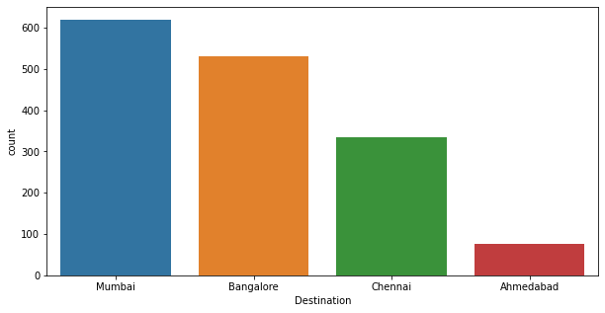

Slide 9
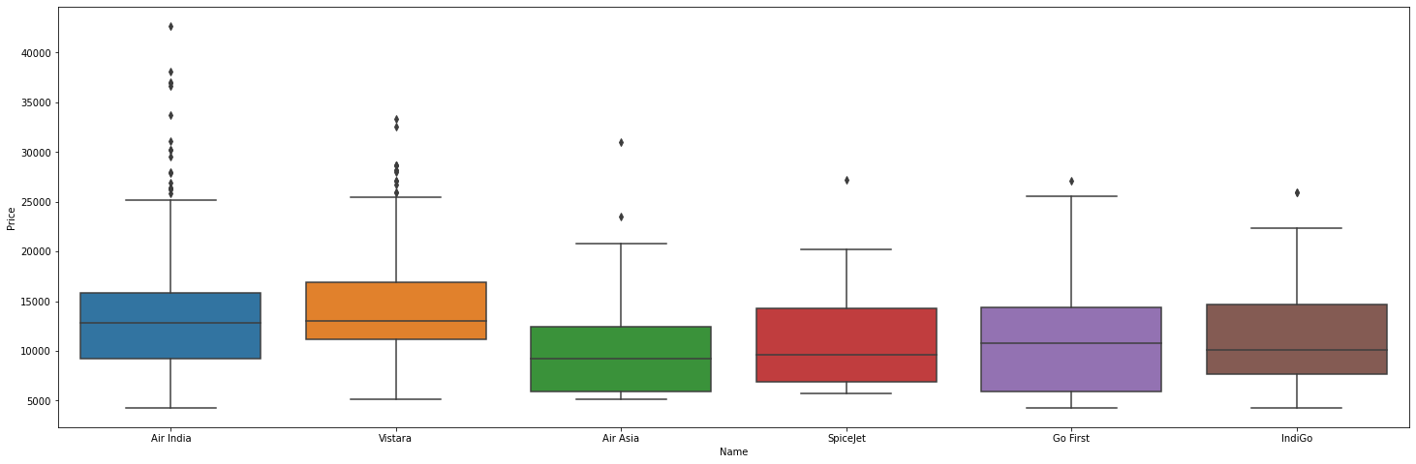
Vistara is showing the highest price having a 2 stops followed by 1 stop.
Spice jet is selling tickets with maximum fare followed by Go first & Vistara

Slide 10
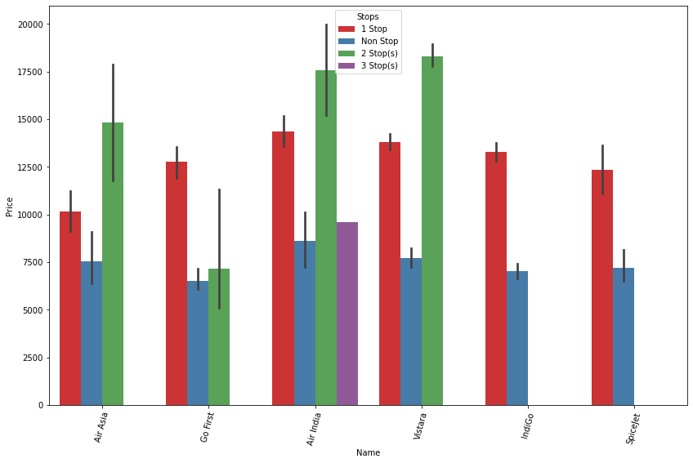

Slide 11
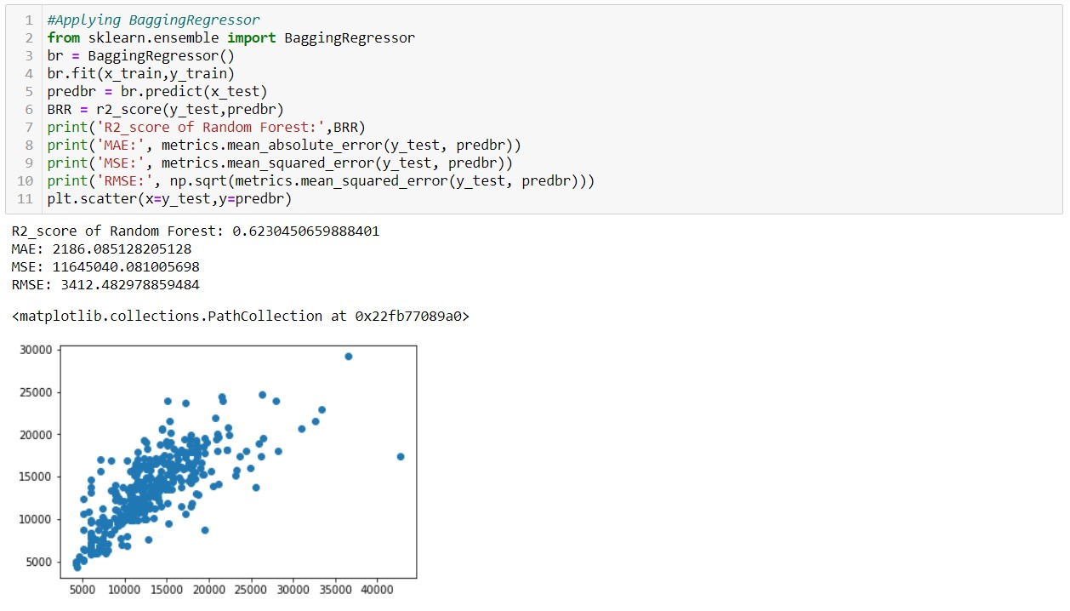
Model Training
Bagging Regressor

Slide 12
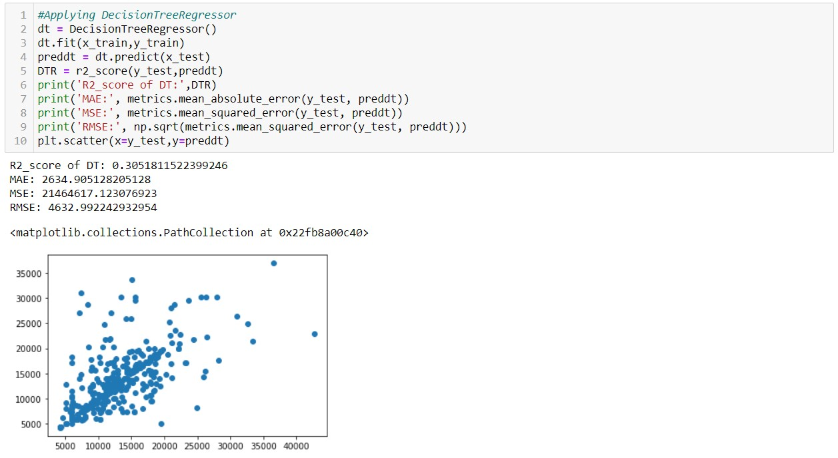
Decision Tree Regressor

Slide 13
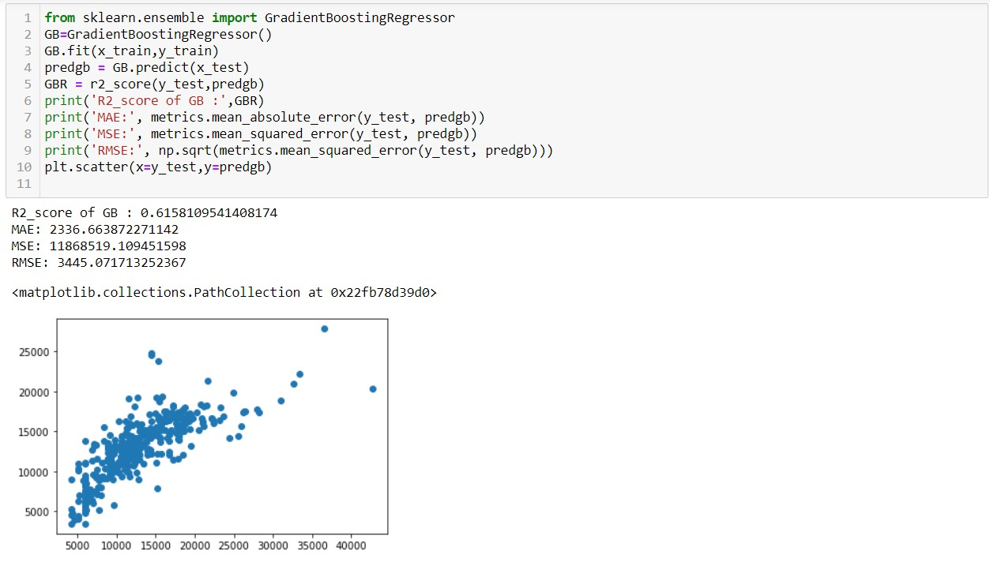
Gradient Boosting Regressor

Slide 14
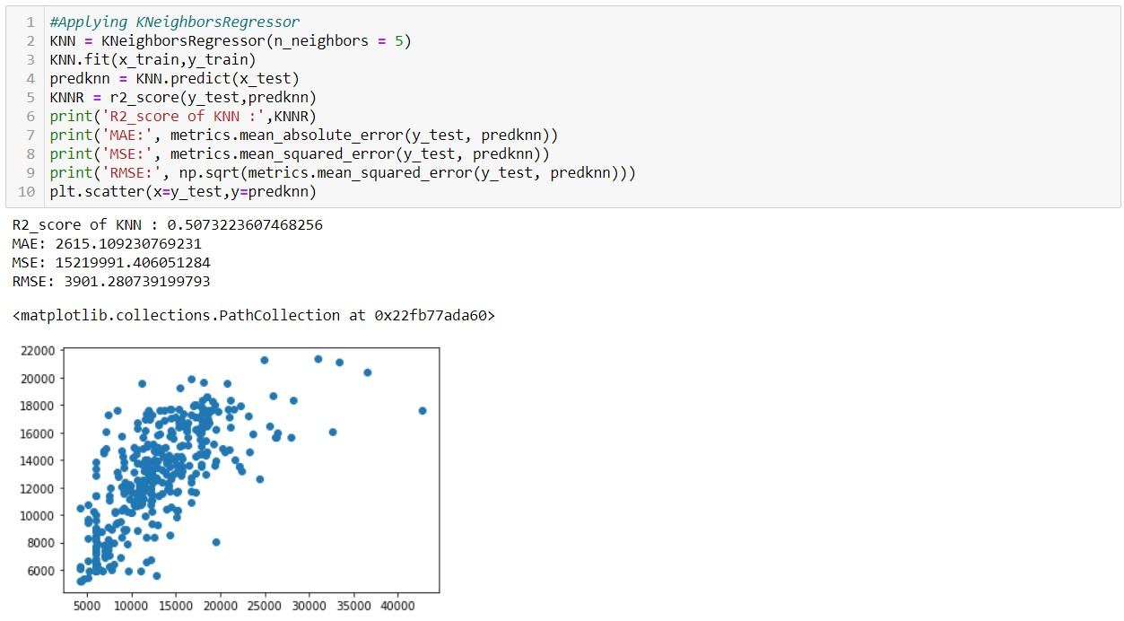
Kneighbours Regressor

Slide 15
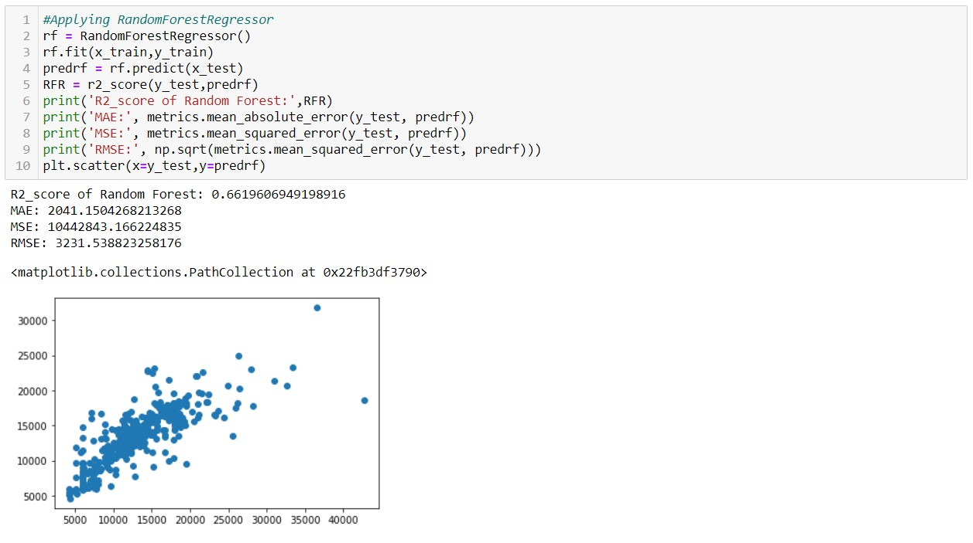
RandomForest Regressor

Slide 16
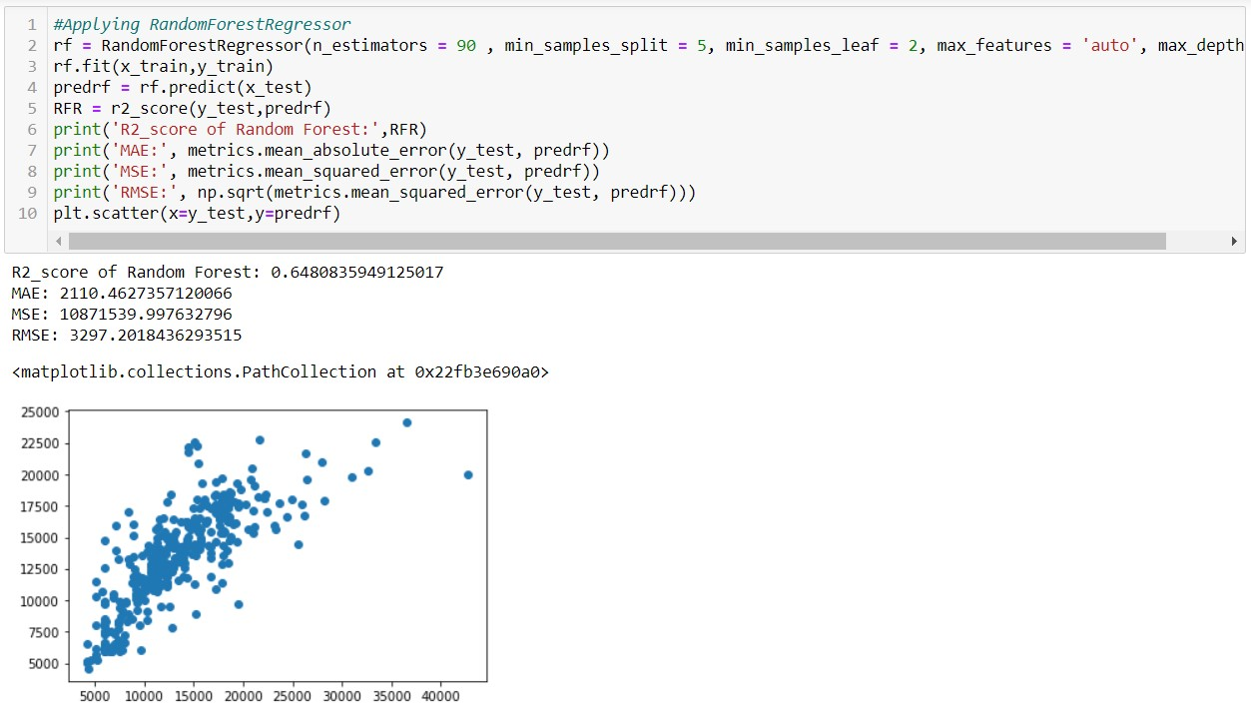
Since RandomForestRegressor is the best model in terms of model score, cross validation difference, test & train, r2 score difference, also as per the evaluation metrics, RandomForestRegressor to be the final model. Lets see if we can increase the score by using hyper parameter tuning.

Slide 17
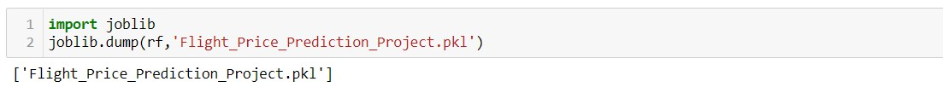
Saving The Model

Slide 18
Conclusion
Flight prices almost always remain constant or increase between the major cities There are two groups of airlines: the economical group and the luxurious group. SpiceJet, AirAsia, IndiGo, Go Air are in the economical class, whereas Jet Airways and Air India in the other. Vistara has a more spread out trend

